Slide 1
Fragments

Slide 2
INTRODUCTION
In Android, Fragment is a part of an activity which enable more modular activity design.
It will not be wrong if we say a fragment is a kind of sub-activity.
It represents a behavior or a portion of user interface in an Activity.
We can combine multiple Fragments in Single Activity to build a multi panel UI and reuse a Fragment in multiple Activities.
We always need to embed Fragment in an activity and the fragment lifecycle is directly affected by the host activity’s lifecycle.

Slide 3
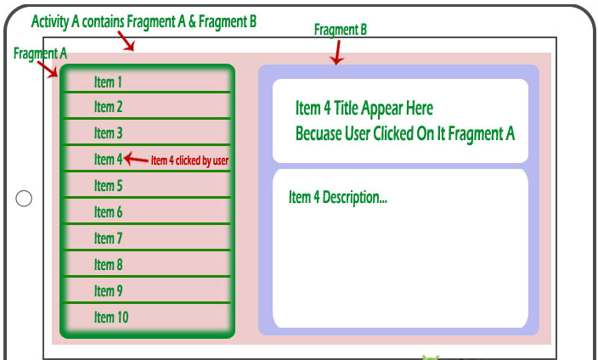

Slide 4
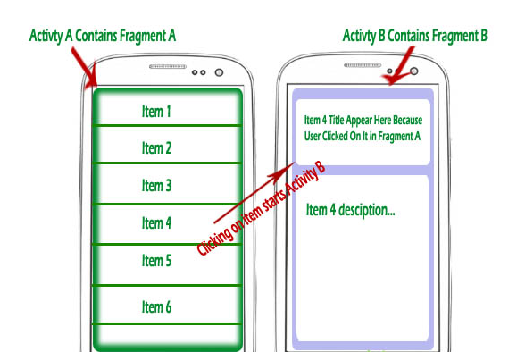

Slide 5
Main use of Fragments in Android
Modularity: If a single activity is having too many functional components, its better to divide it into independent fragments, hence making the code more organized and easier to maintain.
Reusability: If we define any particular feature in a fragment, then that feature more or less becomes a reusable component which can be easily integrated into any activity.
Adaptability: If we break UI components of an app screen into fragments, then it becomes easier to change their orientation and placement, based on screen size etc.

Slide 6
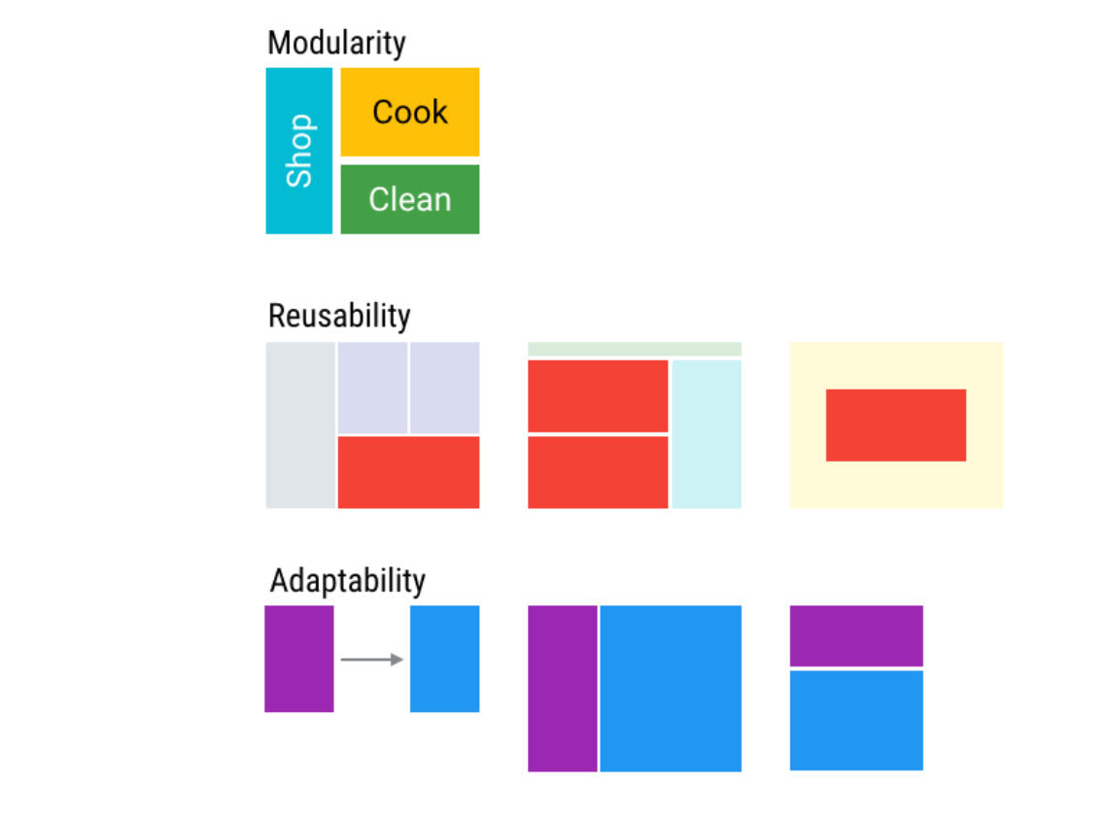

Slide 7
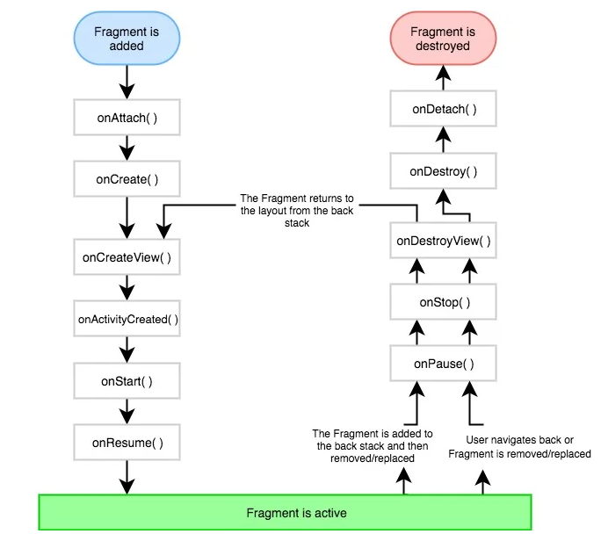
Fragment Life Cycle

Slide 8
onAttach(Activity) | It is called once, when the fragment is attached to the activity.
onCreate(Bundle) | The system calls this method when a fragment is created. This is an important method and you should implement the essential components of the fragment in this method.
onCreateView() | This method is called when the UI of the fragment has to be initialized
onActivityCreated() | This method is called when the host activity is created. By this time, we can even access the fragment's view using the findViewById() method.
onStart() | This method is called when the fragment becomes visible on the device's screen.
onPause() | This is called when a fragemnt is no longer interactive and the user is about to leave the fragment
onStop() | This method is called when the fragment is no longer visible.
onDestroy() | This is called for the final clean up of fragment's state.
onDetach() | It is called just before the fragment is detached from the host activity.

Slide 9
Static fragments
Static Fragment is a type of fragment that is defined in an XML layout file only.
It is a part of the Activity and its lifecycle depends on the lifecycle of its container activity.
Properties of Static Fragment:
Defined using <fragment> tag in XML layout file.
Having a fixed position in the Activity’s layout.
Cannot be removed or replaced at runtime.
Created when the Activity is created and destroyed when the activity is destroyed.

Slide 10
Dynamic Fragment in Android
Dynamic Fragment is a type of fragment that is defined in an XML layout file and called using FragmentManager class.
The FragmentManager class is responsible for managing fragments.
It is a part of the Activity and its lifecycle depends on the lifecycle of its container activity.
Dynamic Fragments are more responsive and flexible than Static Fragments.
Properties of Dynamic Fragment:
Defined in Java class by extending FragmentManager class.
Having a fixed position in the Activity’s layout but its content can be changed.
Can be added, removed, or replaced at runtime.
Created when the Activity is created and destroyed when the activity is destroyed.

Slide 11
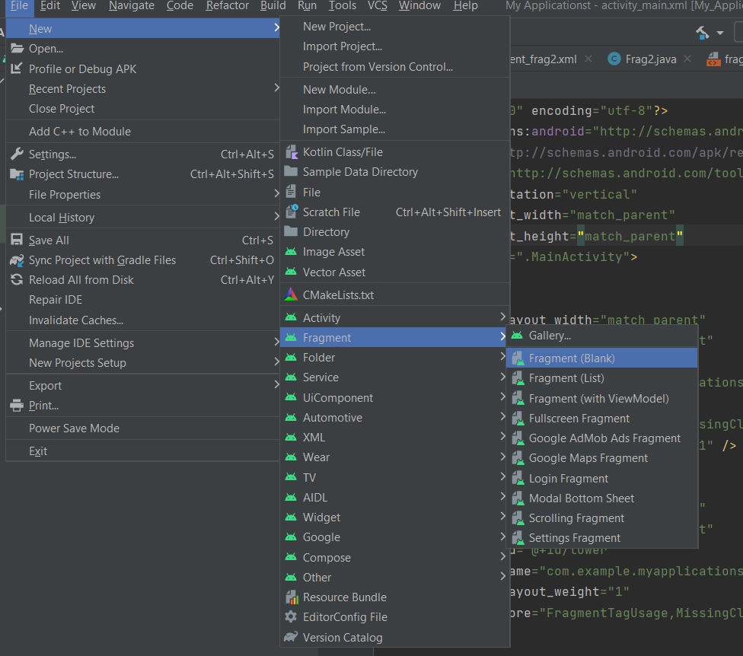
Create A Fragment Class In Android Studio:

Slide 12
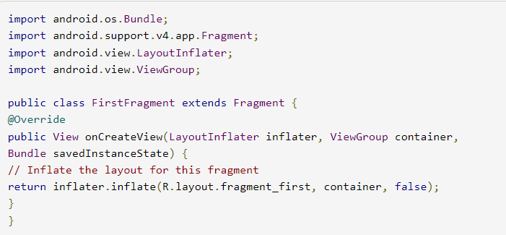

Create A Fragment Class In Android Studio:
the specified fragment is instantiated,

Slide 13
When a fragment is added to a layout, onCreateView will eventually get called, and container is the view that holds the fragment.
That lets you do things like access the parent's layout parameters, the style/theme applied to it, etc.
That's why you pass container when you call inflate, so it can apply any necessary attributes while inflating the fragment's layout.
The inflate() method has three arguments first one is the resource layout which we want to inflate, second is the ViewGroup to be the parent of the inflated layout.
The third parameter is a boolean value indicating whether the inflated layout should be attached to the ViewGroup (the second parameter) during inflation.
UI of the fragment is initialized,

Slide 14
Implementation of Fragment In Android Require Honeycomb (3.0) or Later:
There are some primary classes related to Fragment’s are:
FragmentActivity: The base class for all activities using compatibility based Fragment (and loader) features.
Fragment: The base class for all Fragment definitions
FragmentManager: The class for interacting with Fragment objects inside an activity
FragmentTransaction: The class for performing an atomic set of Fragment operations such as Replace or Add a Fragment.

Slide 15
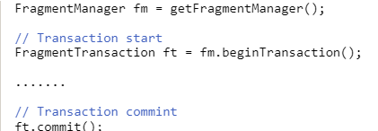
Fragment Manager
As we said before Fragment Manager is the key component.
Using FragmentManager we can discover ( find) fragment inside our layout using findFragmentById or findFragmentByTag.
All the operation that are made by the FragmentManager happens inside a “transaction” like in a database operation.
First, we can get the FragmentManger using the Activity method getFragmentManager().

Slide 16
Android - Shared Preferences

Slide 17
INTRODUCTION
Android provides many ways of storing data of an application.
One of this way is called Shared Preferences.
Shared Preferences allow you to save and retrieve data in the form of key,value pair.
In order to use shared preferences, you have to call a method getSharedPreferences() that returns a SharedPreference instance pointing to the file that contains the values of preferences
Android stores Shared Preferences settings as XML file in shared_prefs folder under DATA/data/{application package} directory.

Slide 18
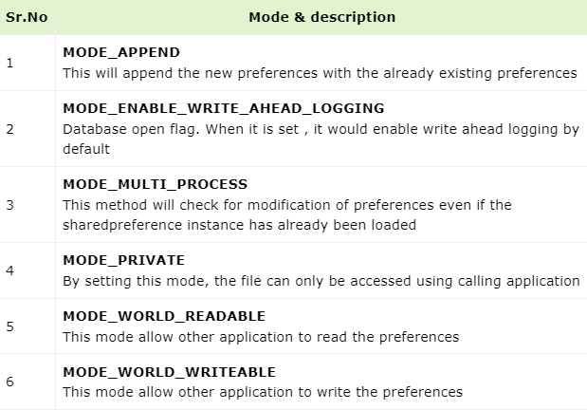
The first parameter is the key and the second parameter is the MODE.

Slide 19

You can save something in the sharedpreferences by using SharedPreferences.Editor class.

Slide 20
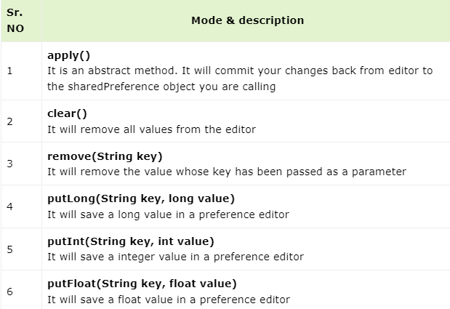
Apart from the putString method , there are methods available in the editor class that allows manipulation of data inside shared preferences.

Slide 21
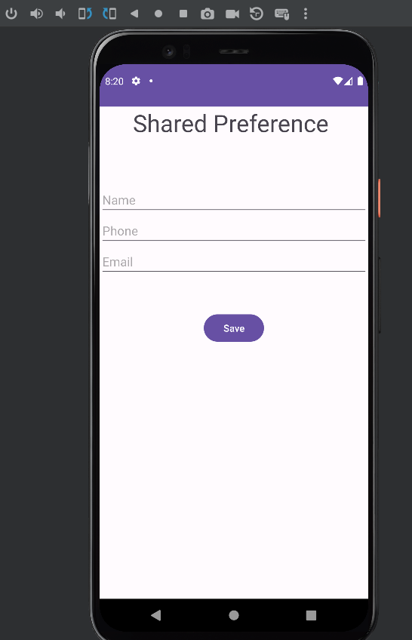
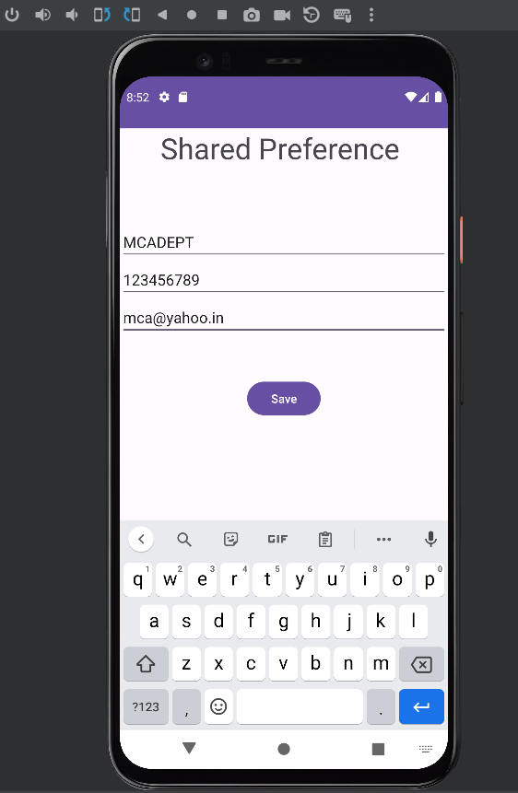
Example:

Slide 22
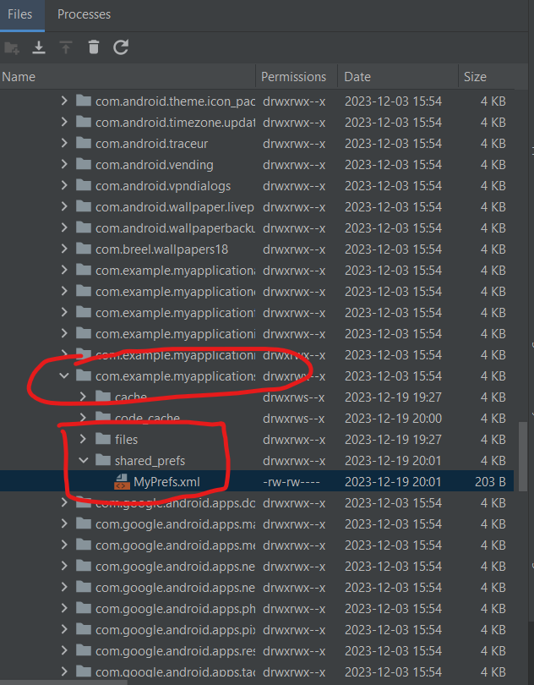
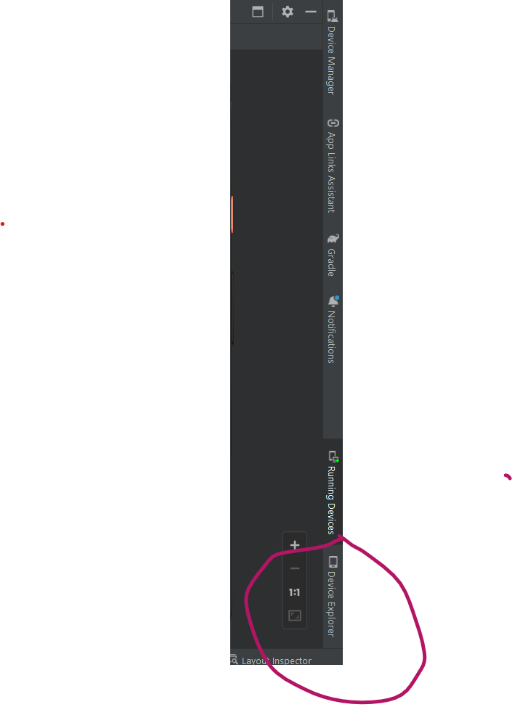

Slide 23
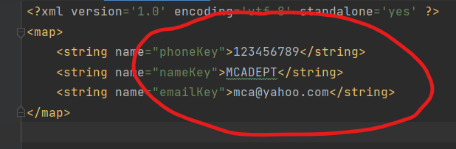

Slide 24
Android - ANIMATIONS

Slide 25
Android Animation is used to give the UI a rich look and feel.
Animations in android apps can be performed through XML or android code
Animation in android apps is the process of creating motion and shape change.
Fade In Animation
Fade Out Animation
Cross Fading Animation
Blink Animation
Zoom In Animation
Zoom Out Animation
Rotate Animation
Move Animation
Slide Up Animation
Slide Down Animation
Bounce Animation
Sequential Animation
Together Animation

